Slide 1
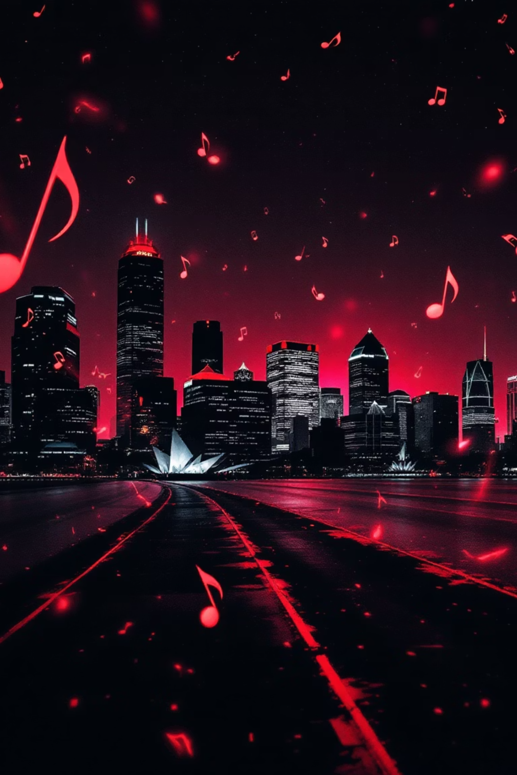
The V List Entertainment Online Mag: Detroit Edition Volume 2
Welcome to the second volume of the V List Entertainment Update, bringing you the latest and greatest from Detroit's thriving music and entertainment scene. This edition features exclusive coverage of the upcoming Bootsy concert event with special guests and behind-the-scenes access you won't find anywhere else.
DD
by Derek Denham

Slide 2
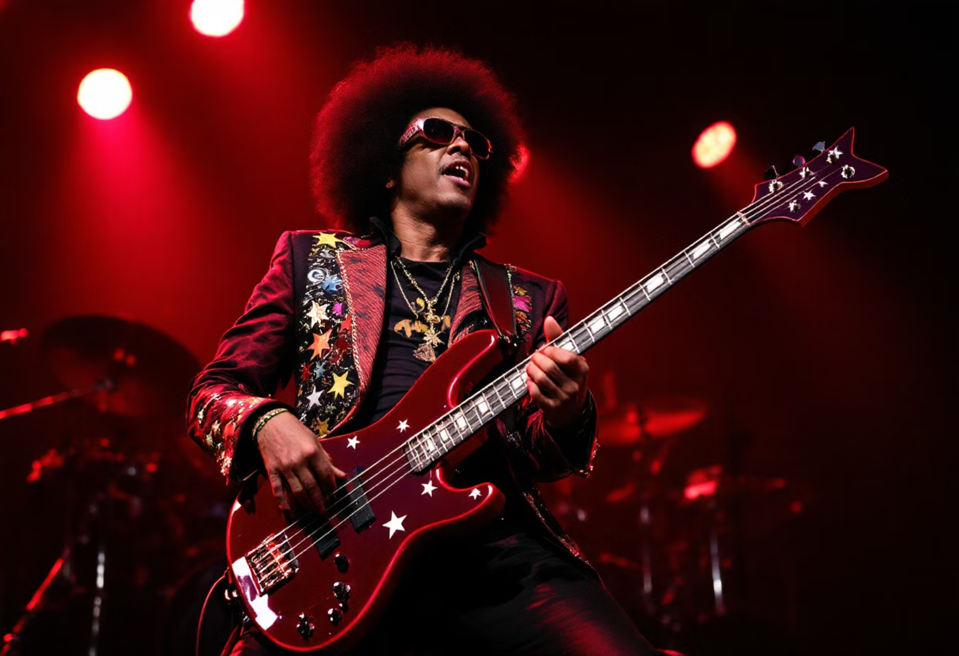
Breaking News: ZAPP BAND honoring Bootsy Collins
Get ready, Detroit! On August 8, the legendary ZAPP Band will be hitting the stage at Music Hall to honor in-person funk icon Bootsy Collins in a night packed with unforgettable grooves and high-energy performances.
This star-studded celebration will feature special guests including Kern Brantley and D-Town Funk, One Way, Lil Asmar, and many more. Don’t miss the exclusive on-stage Q&A at 7 PM, hosted by the V List's Val Berry, followed by the main show kicking off at 8 PM.
Experience the cosmic funk, killer visuals, and deep musical legacy in one electric night. Tickets are on sale now at musichall.org — lock yours in before they’re gone!
Mark your calendars for what will be the funkiest night Detroit has seen in years!

Slide 3
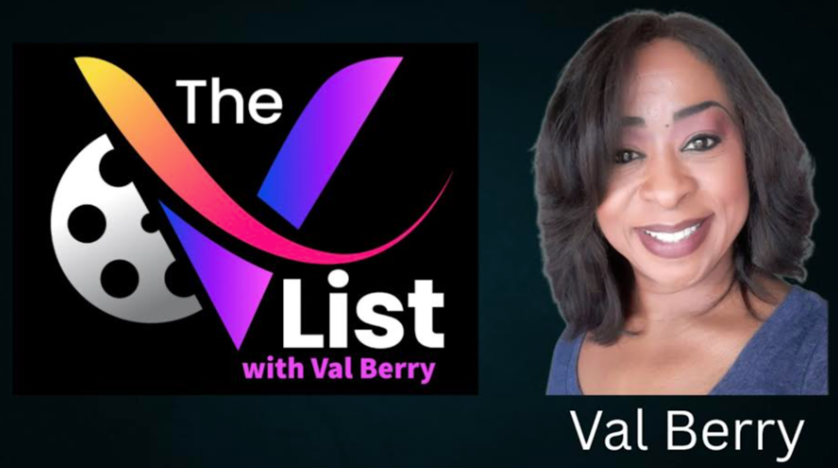
Val Berry's Exclusive Role as Q&A Moderator
The V List's own Val Berry will take center stage as the official moderator for this unprecedented pre-concert Q&A session. As one of Detroit's most respected media correspondents, Val brings deep knowledge and interviewing expertise to this special event.
Val has been preparing extensively for this event, researching Bootsy's legendary career from his early days with James Brown through Parliament-Funkadelic and beyond. Fans can expect insightful questions that will reveal new aspects of Bootsy's artistic journey.

Slide 4
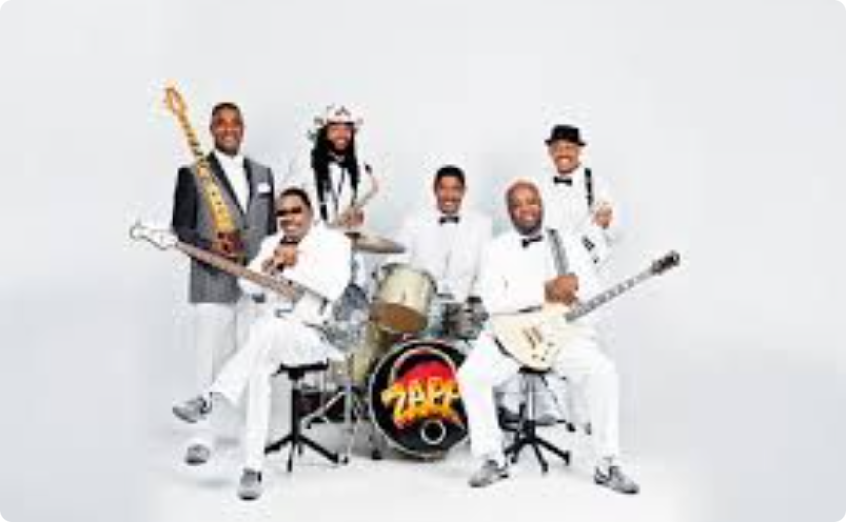
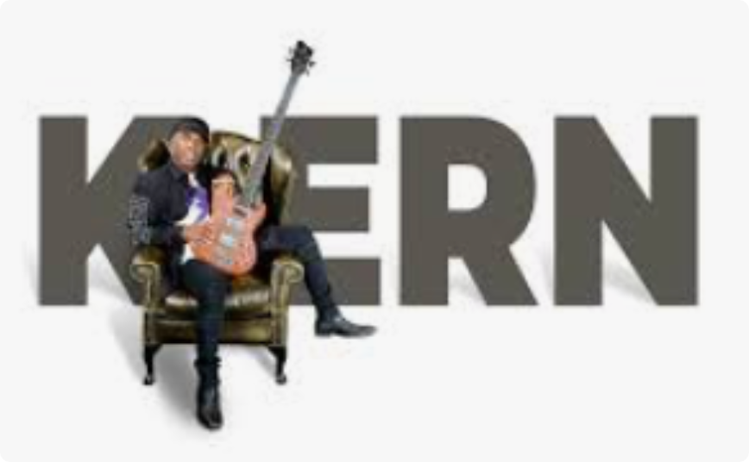

Star-Studded Panel: Zap, Kern Brantley, and More
ZAPP BAND
Legendary funk band known for their electrifying performances and clever lyrics, the tight -knit gorup's songs demonstate a wicked ablility to tell colorful stories and write solid, memorable hooks.
Kern Brantley
Acclaimed bassist and music director who has worked with Lady Gaga, Beyoncé, and other major artists. Born and raised in Detroit, Kern gleaned his style listening to the celebrated Motown artists of the 60's and 70's.
Special Guests
Additional surprise panelists from Detroit's rich musical heritage will join the conversation, offering unique perspectives on funk, soul, and the city's musical legacy.

Slide 5
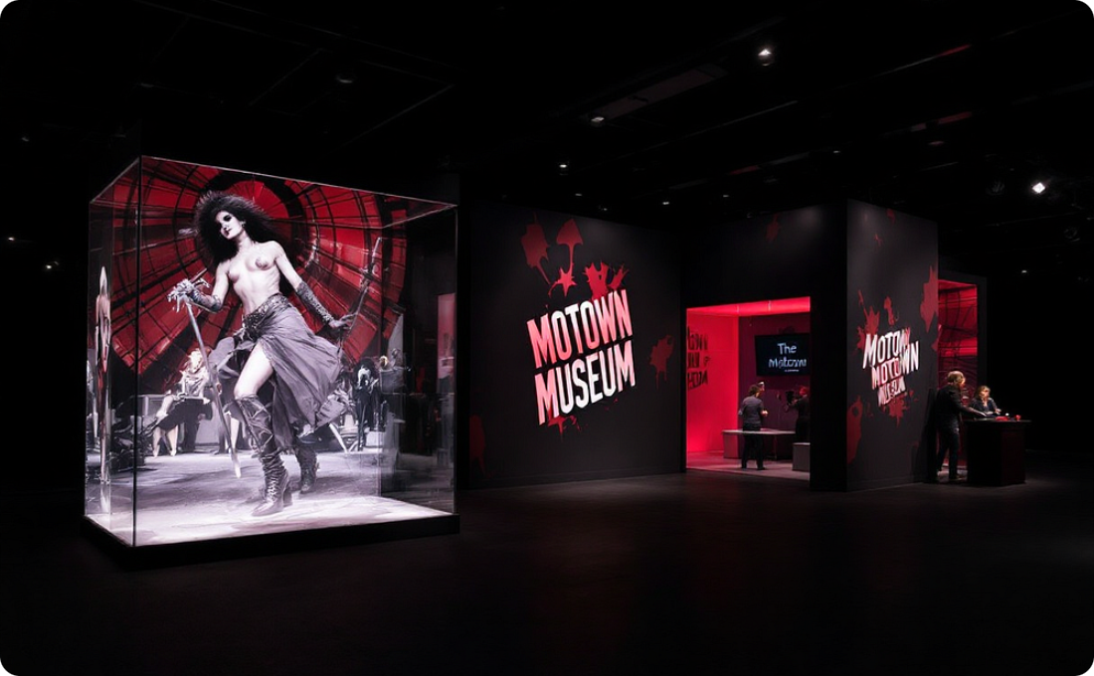
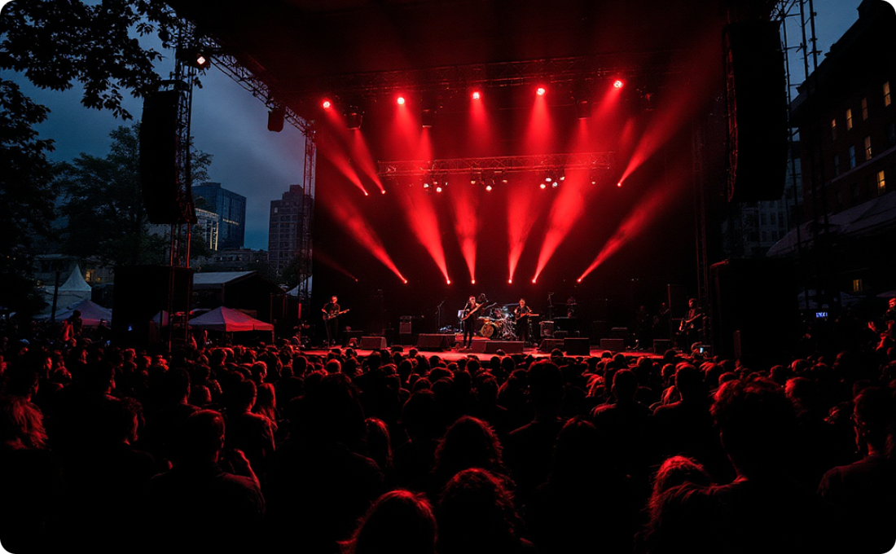
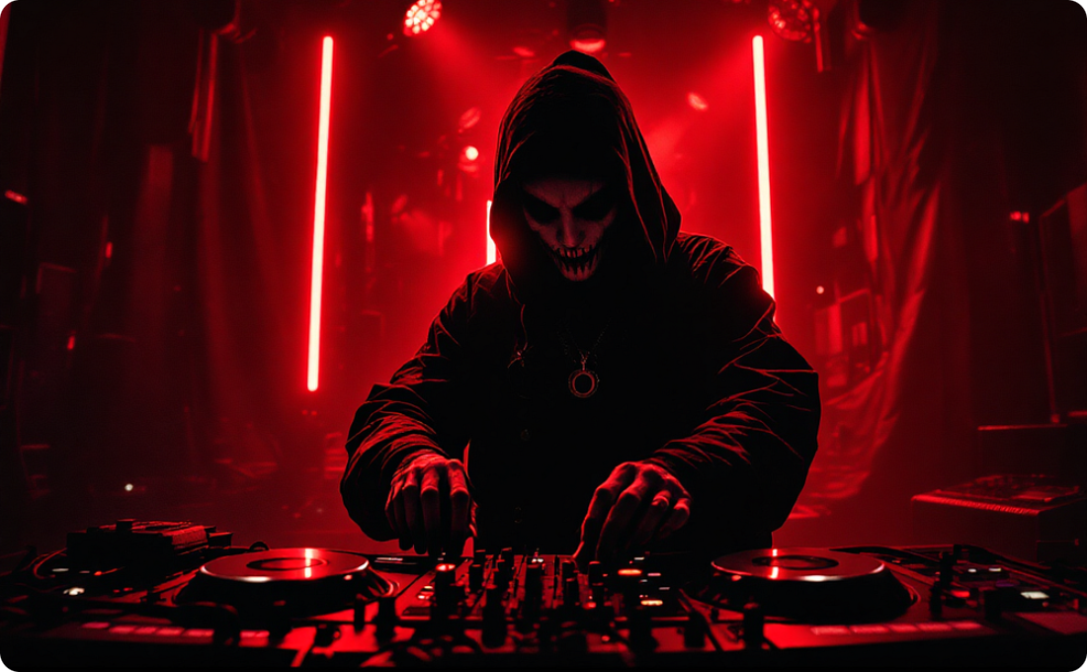
Detroit Entertainment News
Motown Museum Expansion Coverage
Detroit Jazz Festival Highlights
Electronic Music Showcase
Exclusive footage of the ongoing Motown Museum expansion project, featuring interviews with project leaders and previews of new interactive exhibits.
Capture the magic of Detroit's premier jazz event with performance clips, artist interviews, and crowd reactions from this year's festival.
Explore Detroit's influential electronic music scene with footage from recent underground events and interviews with pioneering DJs and producers.
Learn More
Learn More
Learn More

Slide 6
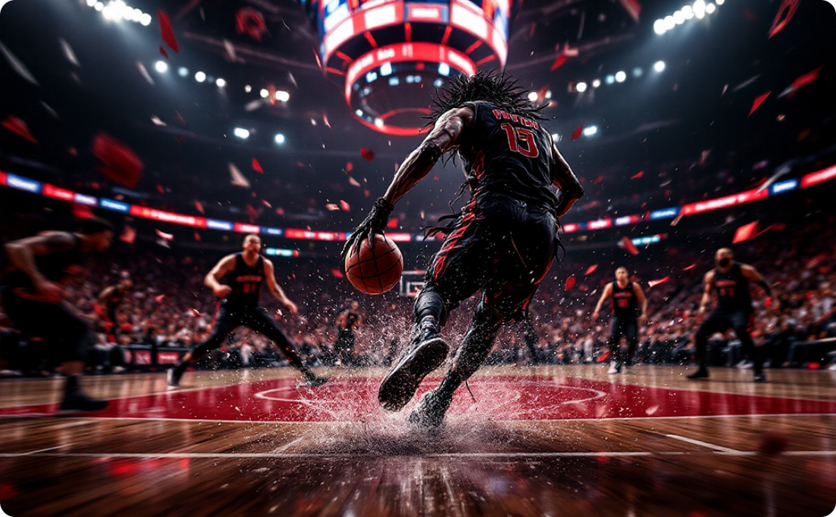
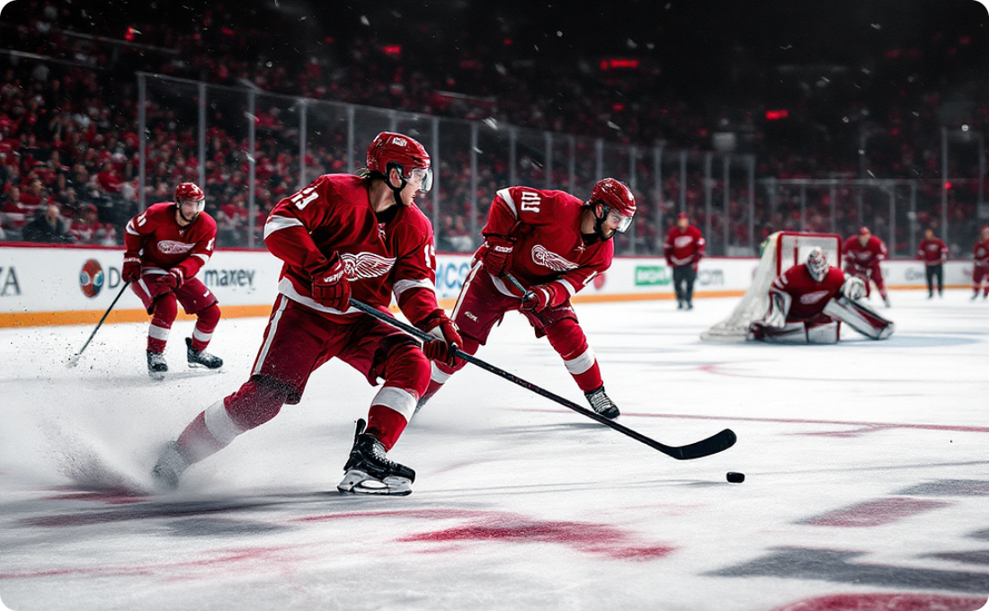
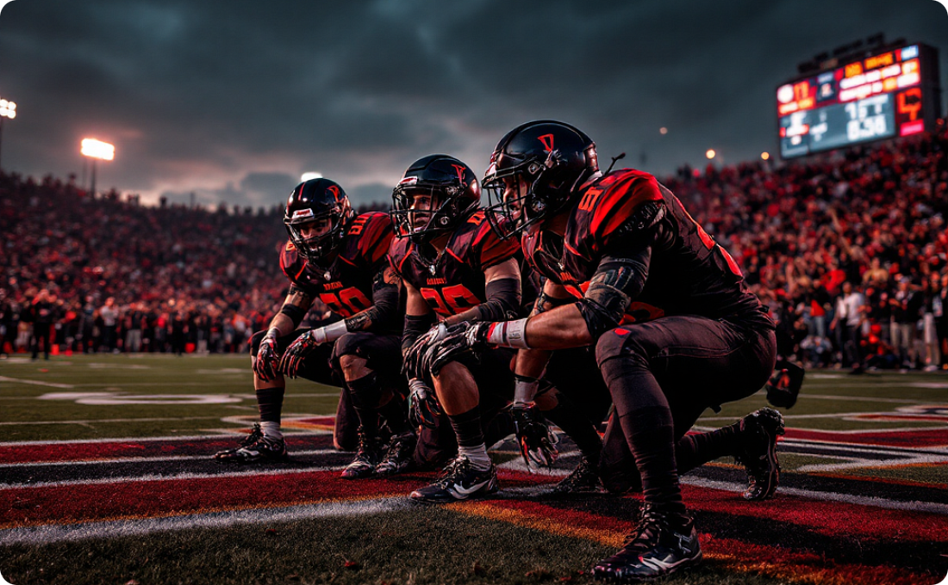
Upcoming Sporting Events in Detroit
Detroit Pistons Season Preview
Red Wings Hockey Highlights
Local Sports & Community Engagement
Get ready for an exciting NBA season! We preview the Detroit Pistons' upcoming games, key player matchups, and what to expect from the team this year. Don't miss out on the action!
Dive into the thrilling world of Detroit Red Wings hockey. We'll cover major games, player spotlights, and the team's journey through the NHL season. Witness the intensity on ice!
Beyond the pros, discover Detroit's vibrant local sports scene. From high school championships to community leagues, we highlight how sports bring our city together. Get involved and support local talent!

Slide 7
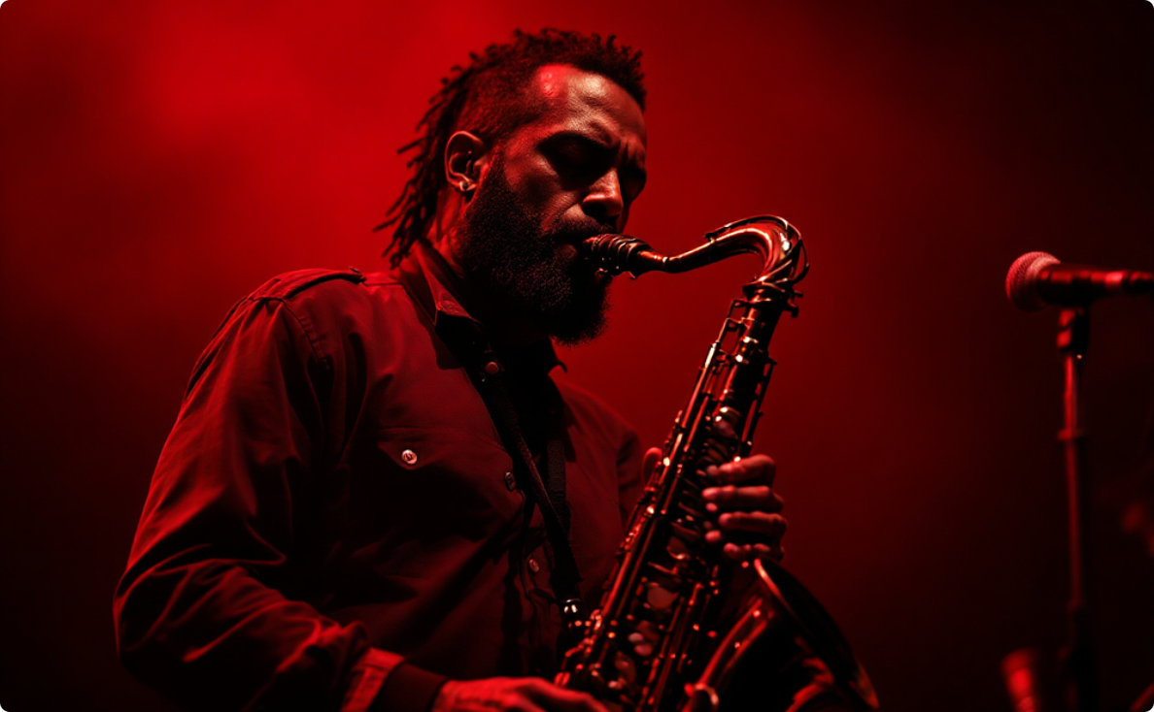
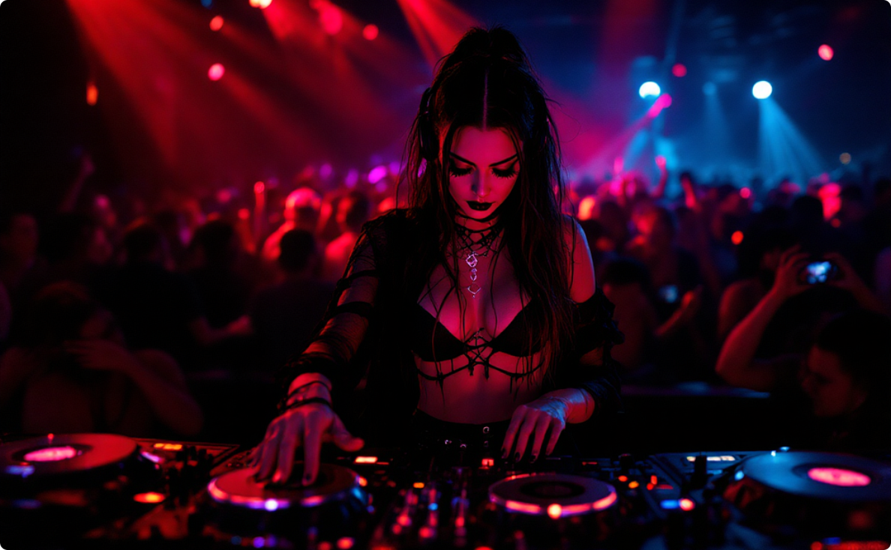
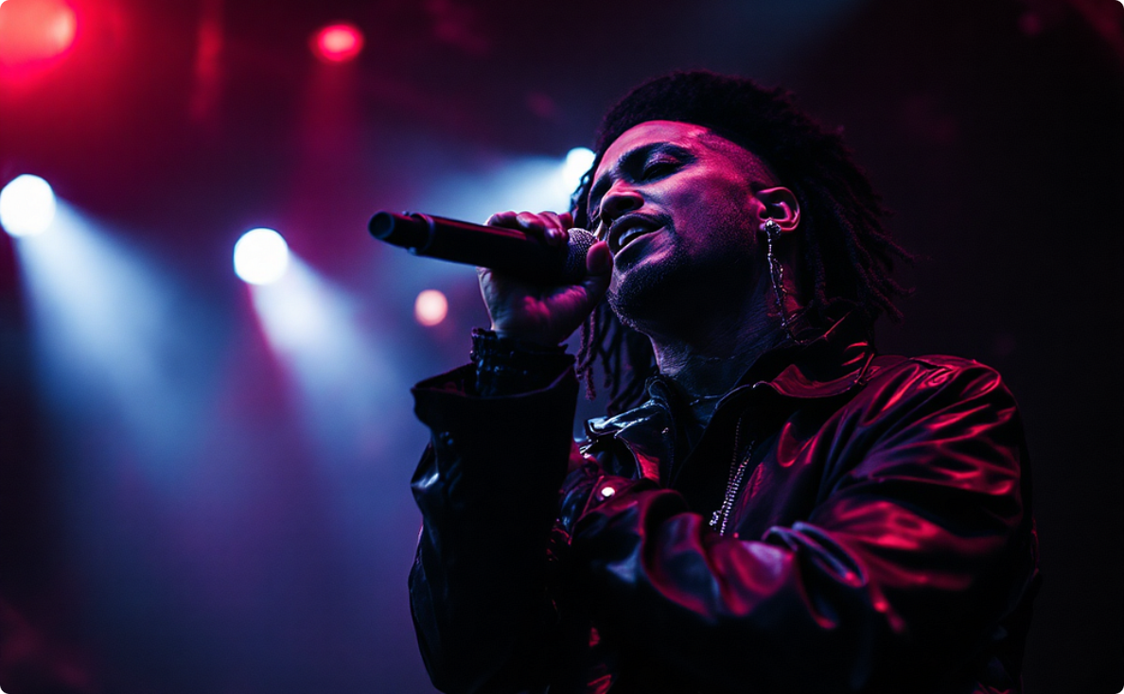
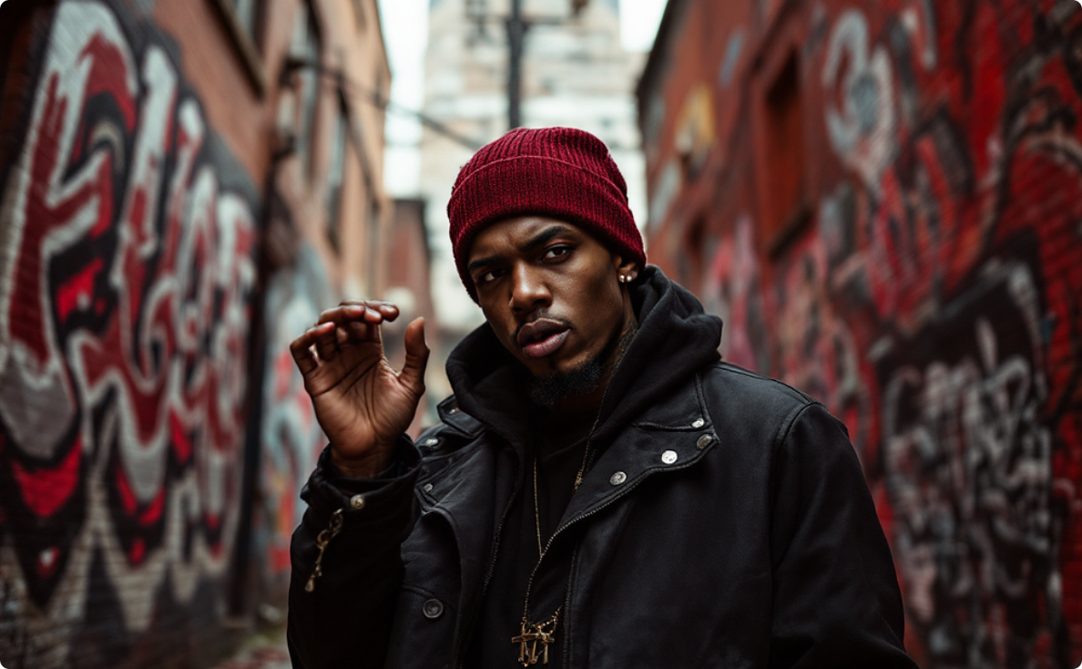
Detroit's Local Music Spotlight: Emerging Talents
Discover the incredible artistry blossoming right here in Detroit. We're shining a light on local musicians who are shaping the city's diverse and dynamic soundscape, from jazz to techno, R&B, and hip-hop.
Jasmine "Jazz" Evans
DJ Cypher
Marcus "Motown" King
A rising star in Detroit's jazz scene, Jasmine's soulful saxophone melodies and improvisational flair evoke the city's rich musical heritage while pushing contemporary boundaries.
Known for her groundbreaking techno beats and electrifying live sets, DJ Cypher is a driving force in keeping Detroit's electronic music legacy vibrant and innovative.
Marcus's powerful vocals and heartfelt lyrics blend classic R&B with modern soul, creating a sound that resonates with audiences and pays homage to Detroit's legendary sound.
Visit Artist's Website
Visit Artist's Website
Visit Artist's Website
Lyric Flow
Lyric Flow delivers sharp, conscious lyrics over captivating beats, reflecting the real stories and vibrant culture of Detroit's streets with authenticity and raw talent.
Visit Artist's Website

Slide 8
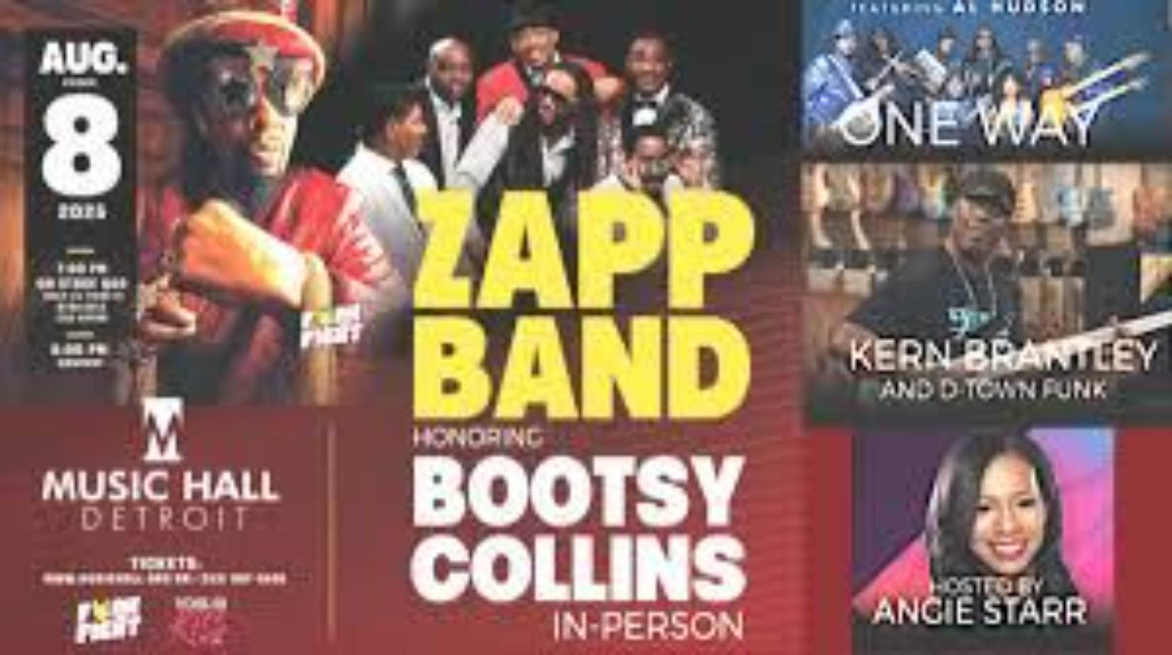


Get Connected: Social Media, Tickets, and V List Updates
Follow V List Entertainment
Instagram: @thevlistshow
Twitter: @VListtvshow
Facebook: The V List
Bootsy Concert Details
Tickets available now at musichall.org
Q&A session requires special pass - limited availability!

Slide 9
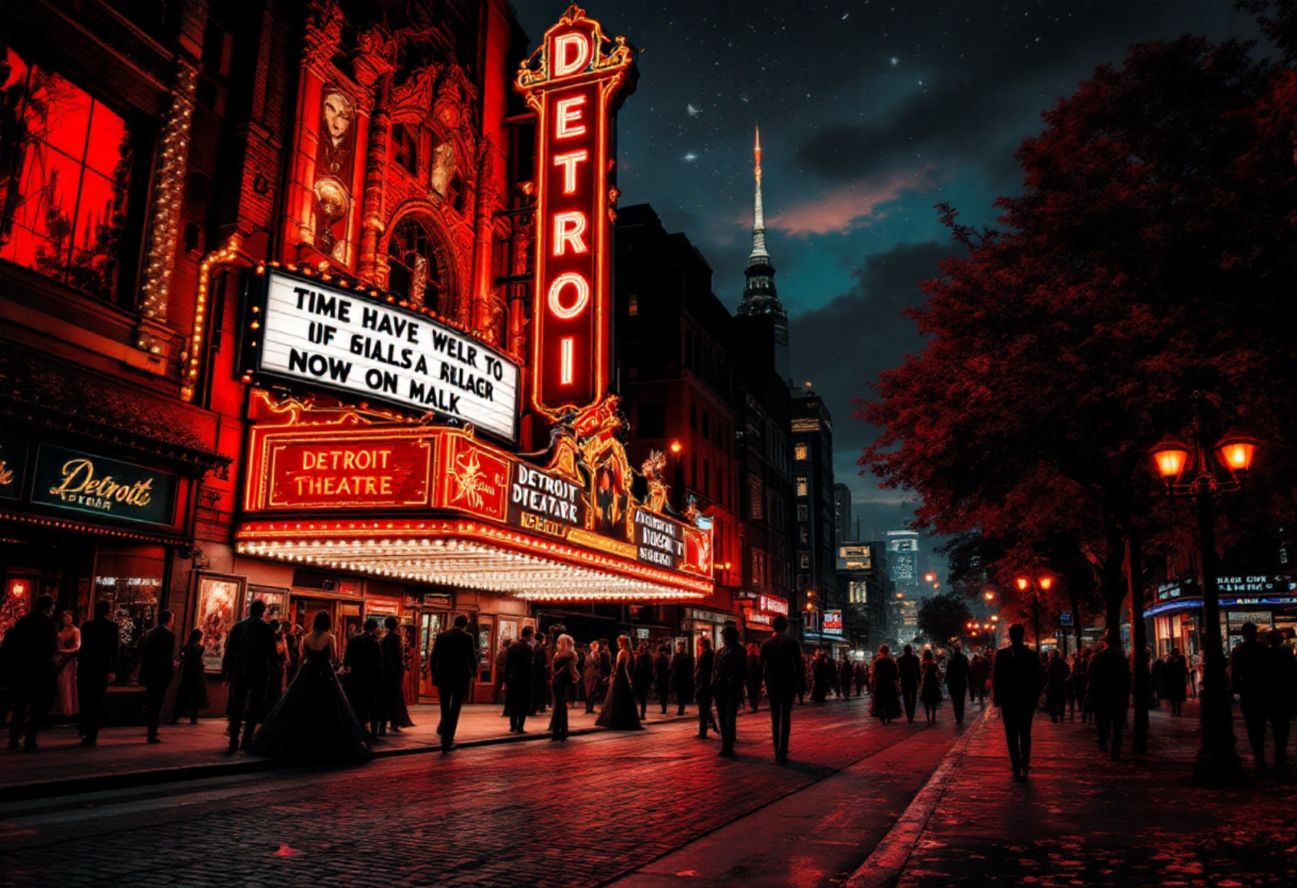
Detroit's Rising Pop Culture Scene
Film Production Boom
HBO's new drama series "Motor City Rising" begins filming in Eastern Market and Corktown districts this month.
Detroit Public Theatre
World premiere of Pulitzer finalist Dominique Morisseau's latest play "Midnight Oil" exploring Detroit's industrial history.
Cinema Detroit
Hosting the Michigan Independent Film Festival featuring 30+ films from local filmmakers with special Q&A sessions.
The historic Fisher Theatre debuts "Motown: The Next Generation" this fall, celebrating Detroit's musical legacy with contemporary performers.
Don't miss the Detroit Institute of Arts' new immersive exhibition "Digital Detroit: Art in the Age of Technology" featuring interactive installations from renowned digital artists.

Slide 10
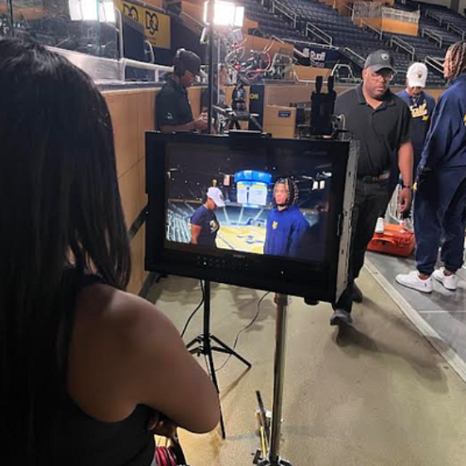
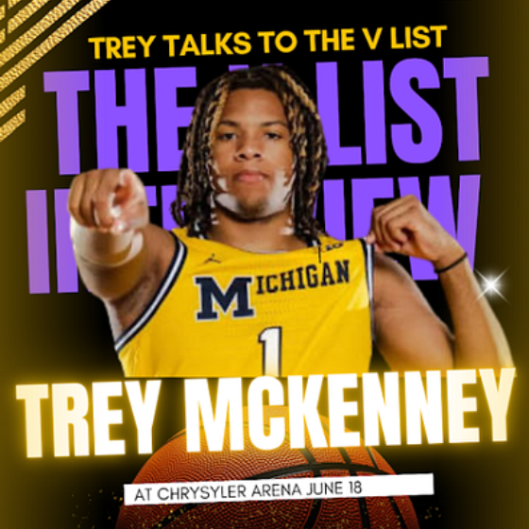
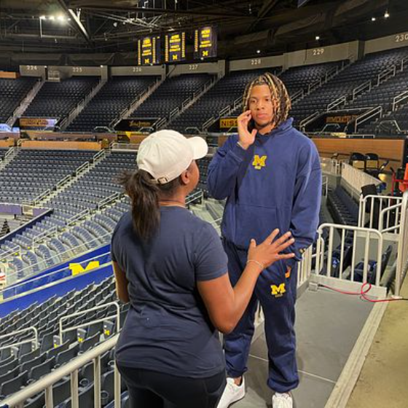

Behind the Scenes with the V List
Exclusive: Trey McKenney Meets The V List
The V List recently went behind the scenes at Crisler Arena in Ann Arbor to interview Michigan's newest basketball sensation, five-star freshman Trey McKenney.
Rising Star
McKenney, the highly-touted recruit from Michigan, discusses his decision to join the Wolverines and his expectations for the upcoming season.
Campus Life
Catch the full segment featuring McKenney's personal journey and basketball aspirations on our website and all V List media platforms soon.
Get an exclusive look at McKenney's transition to college life and his early impressions of Michigan's basketball program.
The V List continues to bring you exclusive access to Detroit and Michigan's brightest talents. Visit thevlistshow.com for more behind-the-scenes content and upcoming features.

